Slide 1

Identifying an EVA Cohort
No unique ICD Code
How to identify the cohort?
Track in the clinic (Dr. Kenna’s Approach)
Text Mining Radiology Reports (CHOP Approach)
Radiology Reports are ‘Semi-Structured’
Organization is stereotyped
Language is idiosyncratic for each clinician
(Some believe verbosity is elegant ;-)
Notes:
1

Slide 2
Text Mining for the Term ‘vestibular aqueduct’
Notes:
2

Slide 3
Text Mining for the Term ‘vestibular aqueduct’
18,919 radiology impressions in AudGenDB
2726 observations can be found with the term, ’vestibular aqueduct`
256 impressions have the term more than twice
Hand-curated 30 of these
21 describe EVA
2 definitely not enlarged
5 used radiology CYA words (ambiguous)
1 duplicate report
1 thin vestibular aqueduct
A list of specific terms assembled
Notes:
3

Slide 4
Text Mining: Regular Expressions
Dispositive Expression (5):
Example: (vestibular(\\n| )aqueducts?.+(is|are|with)(\\n| ) ?(mildly|markedly)?(\\n| )(enlarged|dilated|widened))
Exclusionary Expression – Negative (13):
Example: no( |\n)evidence of enlarg(ed|ement of the) vestibular aqueducts?
Exclusionary Expression – Ambiguous (4):
Example: may represent\nenlarged vestibular aqueducts
Notes:
4

Slide 5
Textmining: Regular Expressions
Dispositive Expression (5):
Example: (vestibular(\\n| )aqueducts?.+(is|are|with)(\\n| ) ?(mildly|markedly)?(\\n| )(enlarged|dilated|widened))
Exclusionary Expression – Negative (13):
Example: no( |\n)evidence of enlarg(ed|ement of the) vestibular aqueducts?
Exclusionary Expression – Ambiguous (4):
Example: may represent\nenlarged vestibular aqueducts
Results: 207 impressions from 191 patients are found using the regex algorithms
Notes:
5

Slide 6
Talk Outline
Audiology Today, 28:42-49 (2016)
Notes:
6

Slide 7
Acknowledgements
CHOP
John Germiller, MD PhD (Oto)
Joy Peterson, AuD (Audiology)
Ian Krantz, MD (Genetics)
Biomedical Informatics
Jeff Pennington (Lead)
Byron Ruth (Web Architect)
Jeff Miller (Imaging)
Aaron Masino (Machine Learning)
Data Science & Biostatistics
Lezhou “Joe” Wu, MPH
Ying Cui, MPH
Baichen Xu, MPH
Clinical Research Coordinators
Emma Kofmehl
Hannah Facey
Danielle Leisner, AuD
Vanderbilt
Linda Hood, PhD (Sub-PI, Audiology)
Jana Shirey-Rice (IT)
John Lee (Audiology)
Boston Children’s Hospital
Margaret Kenna, MD (Sub-PI, Oto)
Tamar Gomes, AuD (Audiology)
Derek Stiles, PhD (Audiology)
Julie Edwards (CRC)
Juliana Manganella (CRC)
External Advisory Board
J. Richard Landis, PhD, (Biostats)
Albert H. Park, MD (Oto)
Beth A. Prieve (Audiology)
Christine Yoshinaga-Itano, PhD (Audiology)

Slide 8
AudGenDB Overview
Pediatric hearing research integrates complex data from varying specialties, on large numbers of patients.
Examples of such data:
Audiogram
Evoked responses (e.g. ABR)
Speech and language performance
Medical and surgical history
Temporal bone imaging
Ancillary laboratory studies
Clinical genetics, dysmorphology
Genotype for known HL genes
Genomic data.
Large-scale hearing research projects would benefit from an integrated electronic database that incorporates these varied data.
Notes:
8

Slide 9
AudGenDB Objective
The overall objective of this project is to develop an integrated biomedical-computing infrastructure incorporating audiologic, otologic and genetic patient data that will provide clinical data for patient-oriented pediatric hearing research, while implementing security and governance structures to ensure patient privacy.

Slide 10
Scope of AudGenDB
Web-based, relational database
Extracts data from the electronic medical record - Audiologic, otologic, radiologic, genetic
All patients who have undergone audiologic testing at CHOP from 2006-Present.
Audiology patients from Vanderbilt University and Boston Children’s Hospital
~175K children total
Intuitive, web-based interface.
Anonymized patient information.
Automatic data refresh pipeline
Notes:
10

Slide 11
Importing Data From Partners
Color Scheme: CHOP Blue, Harvard (BCH) Crimson,
and Vanderbilt Commodore Gold.
Notes:
11

Slide 12
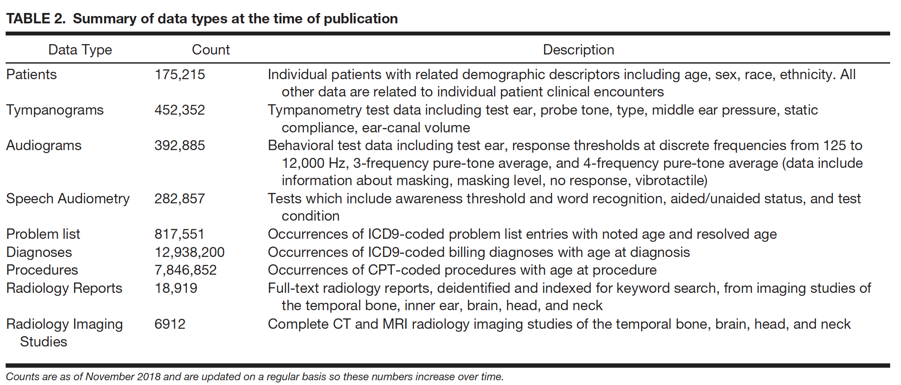
Database Summary

Slide 13
Data Science – Machine Learning
AudGenDB Advantage – Massive Amounts of Data
AudGenDB Disadvantage – Massive Amounts of Data
Difference: Structured vs. Unstructured Data
Unfortunately, Much Unstructured Clinical Data
How Do We Sort Out Unstructured Data?
Manual Curation – Time & Labor Intensive
Machine Learning – Accuracy?

Slide 14
Progressive Hearing Loss: Background
Progressive hearing loss (PHL) has a profound impact on the lives of patients of all ages.
This is particularly true for pediatric patients where critical developmental periods influence language, educational, and social development
A common question that clinicians are asked by patients and parents is whether a hearing loss (HL) will change, particularly worsen, over time.
Although some clinical factors (genetics, chemotherapy, infection) are associated with PHL, much remains to be understood about the role that these co-morbidities/treatments/associations play in PHL and how their interaction affects the outcome.
Our current understanding of PHL and the ability to predict which patients will ultimately develop PHL is poor.
Notes:
14

Slide 15
PHL Prognoses: The Numbers
As part of the evaluation of patients with hearing loss, the Audiology Department at CHOP answers several questions about the patient in a “flow sheet” in the Epic EHR.
One question asks the audiologist to identify patients at risk for hearing loss progression.
405 flow sheet responses were retreived from the EHR, and evaluated their accuracy.
76 patients meeting our rigorous inclusion criteria.
Of this group, 16 patients actually progressed
Accuracy rate of 21%.
Notes:
15

Slide 16
Overview of Approaches: Progressive Hearing Loss
Traditional Statistical Approaches
Linear Regression Demonstrates an association with cholesteatoma
Jordan Racca with present the data later
Text Mining
EVA is not encompassed in a diagnosis code
Text mining of radiology reports provides a means to find an EVA patient cohort
Example: Regular expression query to find EVA patients
Machine Learning/ Natural Language Processing (NLP)
NLP used to generate ”features"
Machine Learning can then act on these features
Example: Finding radiology reports with ”abnormal’ inner ear morphology
Artificial Intelligence (AI)
Clinical Decision Support (CDS)
Ultimate goal to facilitate clinical care of PHL patients

